Slide 1
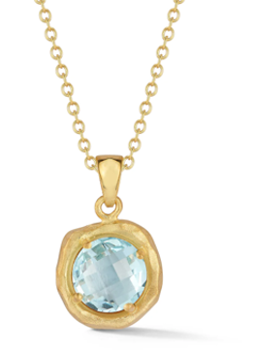
Live Auction
L-1 – Blue Topaz Pendant Necklace
This gorgeous 16” Solid 14-Karat Gold Necklace features:
A 14-Karat Yellow-Gold and Hammer-Finished Pendant
Set with a 1.75-Carat Checkerboard-Faceted Blue Topaz semi-precious gemstone
On a 16” Solid 14-Karat Gold Chain
Perfect for Every Day as well as Special Occasions
Donated by: Alexander J. Bongiorno Jeweler - Troy
Value: $1,950
Starting Bid: $500

Slide 2
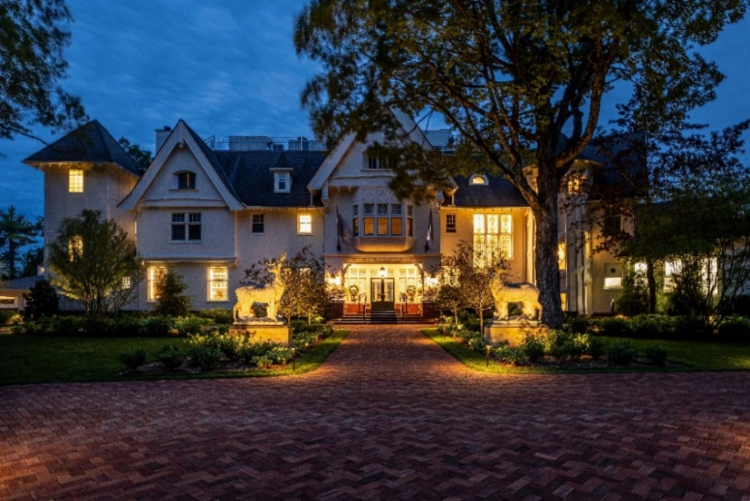
Live Auction
L-2 – Ultimate Mackinac Escape –
The Inn at Stonecliffe
Experience the perfect blend of luxury
and charm at The Inn at Stonecliffe
Package includes a 2-Night Stay for
2 guests
Best Available Room, subject to availability
Enjoy the Numerous Amenities, including (2) Pools
Includes Dinner for 2 (up to $200)
to enjoy during your stay
Valid through October 2026
Donated by: Pulte Family Charitable Foundation
Value: $1,800
Starting Bid: $500

Slide 3
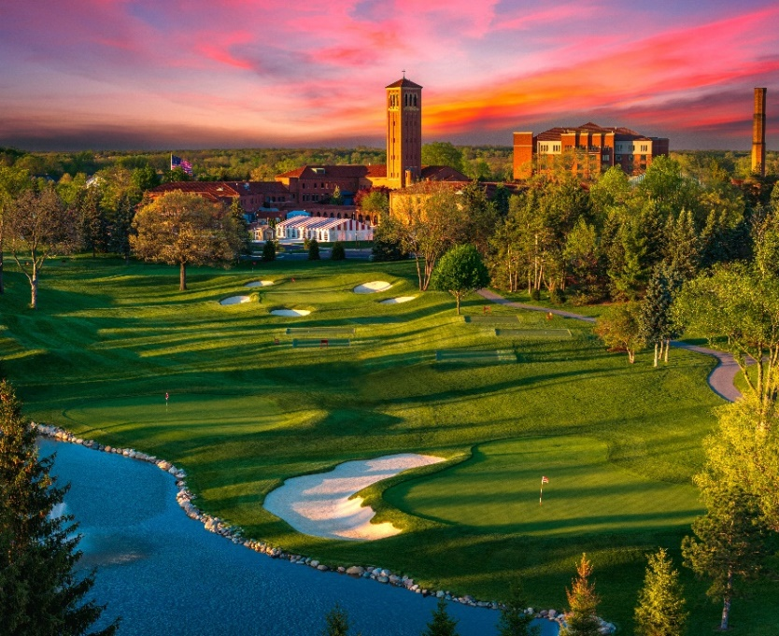
Live Auction
L-3 – Saint John’s Resort
Stay & Play Golf Package
Two (2) couples will enjoy a 1-Night Stay at Saint John’s Resort (2 rooms, 4 guests)
Tee off on the first new metro Detroit golf course in 20+ years!
Includes 2 Rounds of 18 holes at The Cardinal - A championship 7,000 yard course
$200 Dining Credit
  Redeemable at Five Steakhouse, The Wine Grotto or Doyles Irish Pub
Package is subject to availability
Donated by: Pulte Family Charitable Foundation
Value: $2,500
Starting Bid: $500

Slide 4

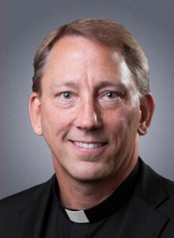
Live Auction
L-4 – Fr. John Dudek’s
“My Big Fat Greek Dinner!”
Enjoy a BIG FAT GREEK DINNER at your home for you and your guests!
Main course prepared by Fr. John Dudek, Pastor of St. Regis, Bloomfield Hills
Fr. John will bring a BBQ spit, and a lamb to roast, plus
Homemade Spanakopita (spinach pie) prepared by a friend of his
This package also includes:
  A $250 Plum Market Gift Card*
  A $100 Astoria Pastry Shop Gift Card*
  (*The (2) Gift Cards: Will allow the winner to shop for additional dinner
  items they would like to prepare and serve that evening)
Invite up to 20 guests
Fr. John will also celebrate Mass and provide a Home Blessing
On a mutually agreeable date in 2026
Donated by: Fr. John Dudek + Plum Market + Astoria Pastry Shop
Value: Priceless
Starting Bid: $500

Slide 5
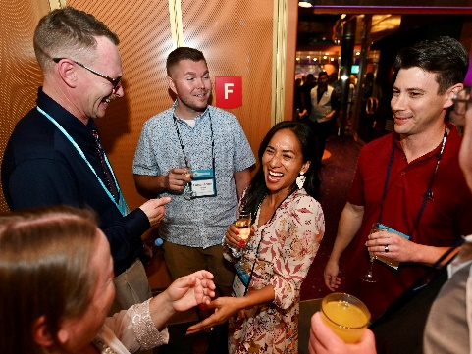
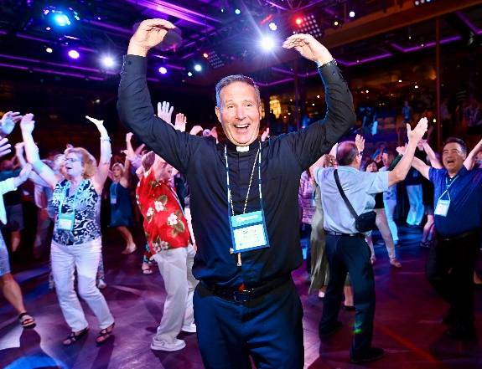

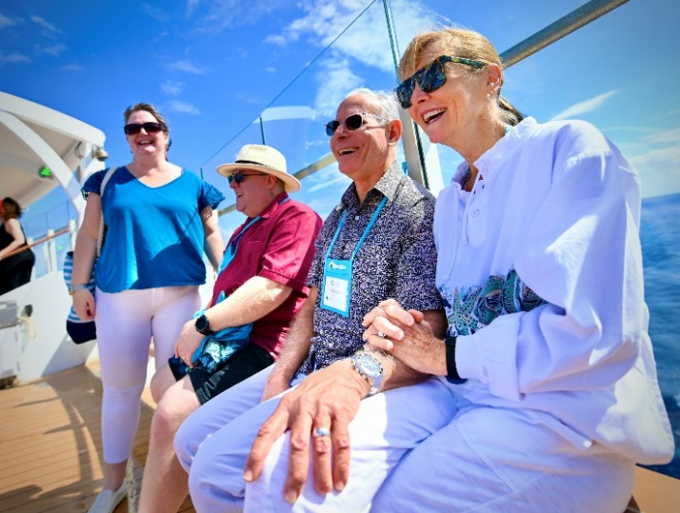
Live Auction L-5 –Good News Marriage Cruise
A Catholic Cruise That Will Change You Forever!
Includes:
A (7) seven-day cruise for two (21 & up) from Feb. 6–13, 2027
Departure from Ft. Lauderdale to Miami & the Bahamas
A Balcony cabin on Holland America’s Eurodam
An Incredible lineup of inspiring speakers & performers, including Fr. Mike Schmitz, Cardinal Timothy Dolan, Kimberly & Dr. Scott Hahn, Dr. Ray Guarendi, Fr. Joe Krupp & more
A special performance by Harry Connick, Jr.
Time for personal rejuvenation and spiritual retreat
Daily Mass
Opportunities to make new friends & special memories
Experiences to build and nurture marriage
Port taxes & gratuities
(Airfare not included)
Donated by: Corporate Travel Services
Value: $8,246
Starting Bid: $1,000

